Slide 1



Daily Marketing Report
View in Power BI
Last data refresh:
12/19/2018 1:52:44 PM Romance Standard Time
Downloaded at:
12/19/2018 4:51:20 PM Romance Standard Time

Slide 2
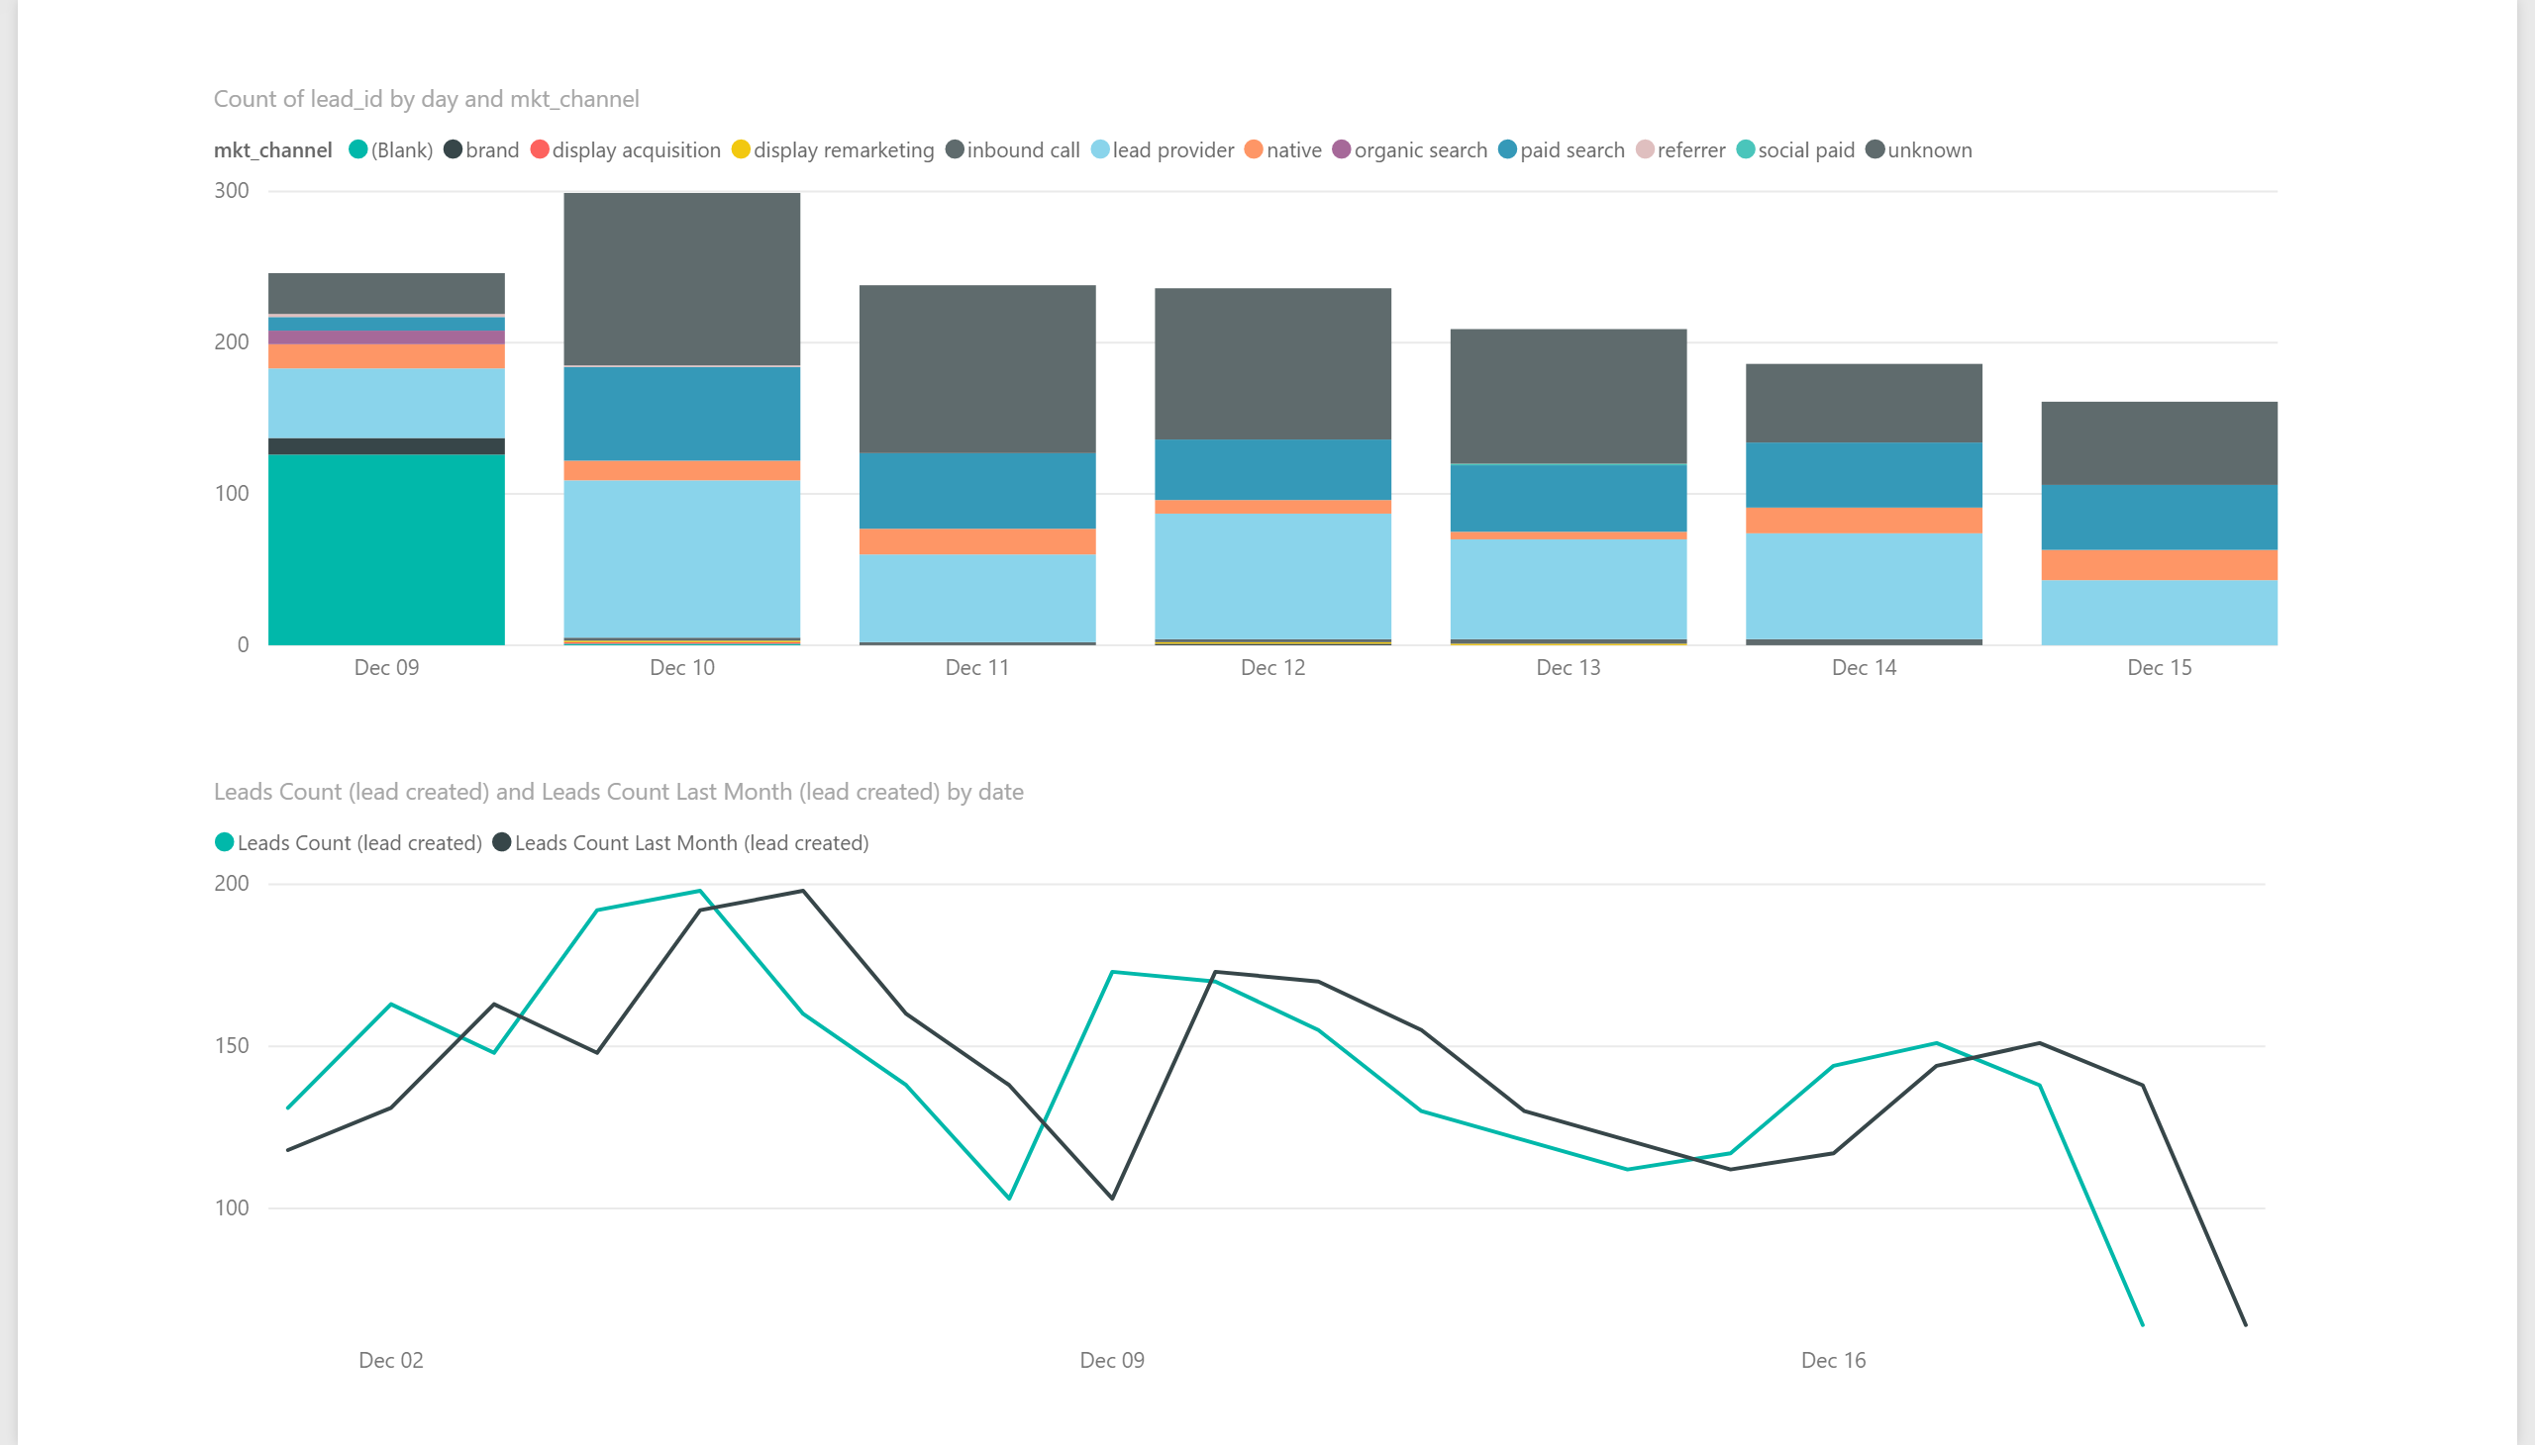

Slide 3
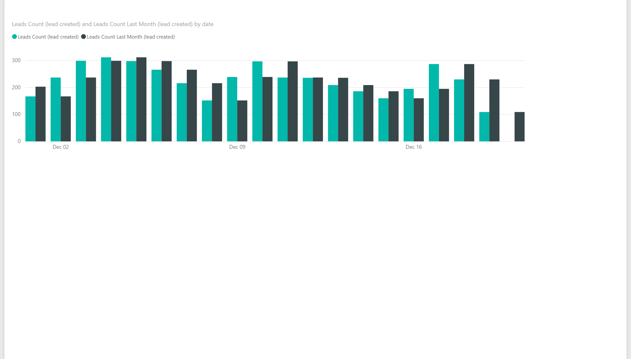

Slide 4
